Slide 1

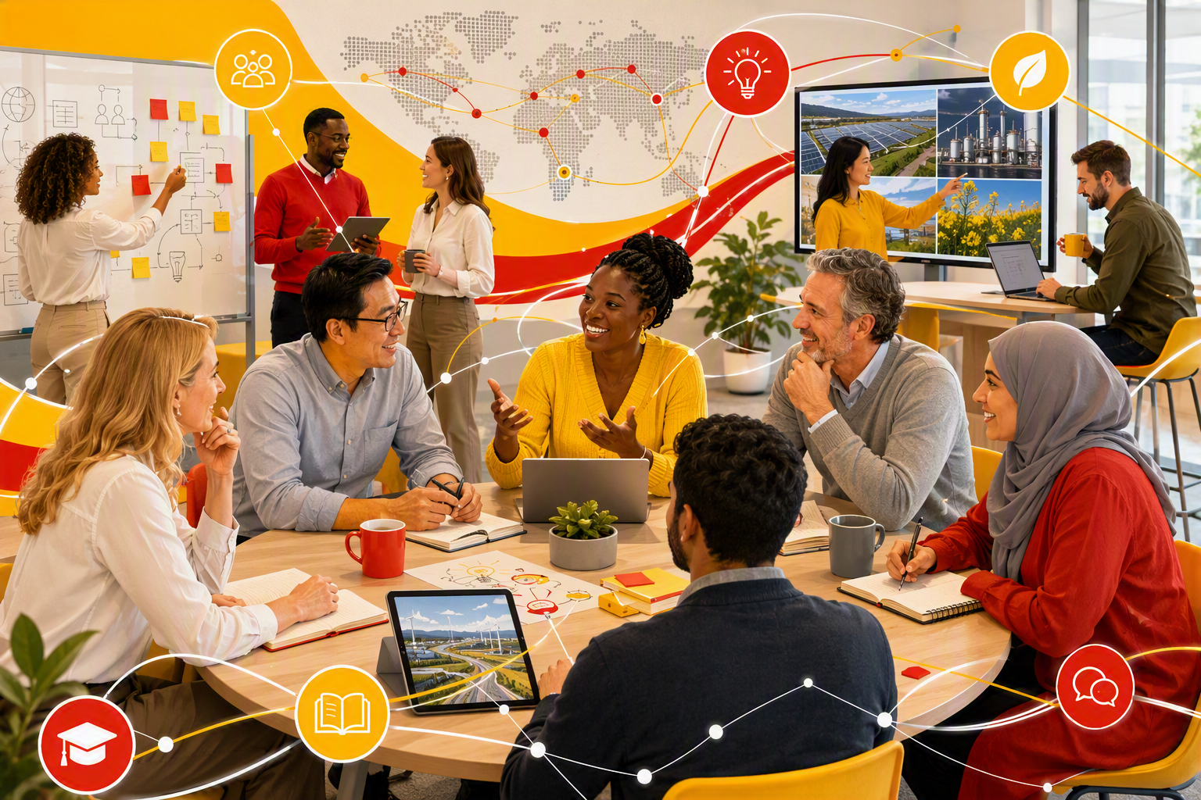
COLLABORATION & LEARNING
LEARN & ENGAGE
Connect. Learn. Apply.
SHAPE
CONNECT
ACCELERATE
A community where people connect across teams, learn through shared perspectives and apply insight in practice.
Aygun Boutkan | Scenarios Project Advisor
SCA Global Team F2F 2026 | 7–8 September
CONNECTING PEOPLE THROUGH KNOWLEDGE
WHY JOIN?
CONNECT PEOPLE
EXCHANGE PERSPECTIVES
APPLY KNOWLEDGE SHARING
The Learn & Engage sessions bring people together from various teams, around relevant and impactful topics. It helps break down silos, brings in multiple perspectives and balances learning with knowledge sharing. The Lear and Engage sessions are informal and interactive, peer-to-peer sessions to connect, ask questions, gain a deeper understanding, and engage and share knowledge
LEAR AND ENGAGE TOGETHER
FOUR INGREDIENTS OF A GREAT SESSION
01
PURPOSE
02
FORMAT
03
AUDIENCE
04
EXPERIENCE
What will people take away?
OUTCOME • RELEVANCE
How will people participate?
CONVERSATION • INTERACTION
Whose perspectives matter?
EXPERIENCE • DIVERSITY
How will people connect?
CONNECTION • CONTRIBUTION
THE LEARN & ENGAGE RHYTHM
A SIMPLE CYCLE THAT TURNS CURIOSITY INTO SHARED PRACTICE
1
DISCOVER
2
CONNECT
3
EXCHANGE
4
LEARN
5
APPLY
6
IMPROVE
7
ENGAGE
Learn from each other
Bring people together
Share different perspectives
Build understanding
Put insight to work
Refine through practice
Keep the cycle moving
REPEAT • EACH SESSION BUILDS CONNECTION, CAPABILITY AND MOMENTUM
FEATURED CONVERSATIONS + IMPACT
FEATURED CONVERSATIONS
IMPACT
• Geopolitical Insights
• IEA World Energy Outlook
• Global Economic Outlook
• Energy Security Scenarios
• Enhanced Geothermal Systems
• BloombergNEF New Energy Outlook
BROADER PERSPECTIVES Understanding the forces shaping the future
STRONGER CONNECTIONS Building relationships across teams
ACTIONABLE INSIGHTS Turning learning into practical next steps
JOIN THE CONVERSATION
BRING A QUESTION • SHARE KNOWLEDGE • LEAVE WITH ONE INSIGHT
LEARNINGS AT A GLANCE | 20 FEATURED CONVERSATIONS • FUTURE-FOCUSED THEMES • GLOBAL PARTICIPATION • INTERNAL + EXTERNAL VOICES
Shape. Connect. Accelerate.
Contact Aygun Boutkan | Scenarios Project Advisor
September 7–8, 2026

